Slide 1
Vero Training Session

Slide 2
Agenda for Today’s Training Session
Study introduction - what is a Vero, and where do I fit into all of this?
Vero animations
Vero conditions/scripts
Vero rules
Next steps

Slide 3
Study Introduction

Slide 4
Participant’s Session Agenda
Welcome & Introduction
Study Tasks
Debrief

Slide 5

Your tasks
You are about to join a team that will complete several tasks: (list study tasks here)

Slide 6
Participant view of the tasks you’re involved in...

Slide 7
Participant tasks
(describe what study participants see here)

Slide 8
Data Collection Session

Slide 9
Vero General Responsibilities
Look like a Vero (prepare your tech)
Move like a Vero - change your backgrounds while in session to move like a Vero
Talk like a Vero - study, practice, and use script to talk like a Vero, depending on your condition

Slide 10
Look like Vero
Before the Session
Set up Vero in Zoom.
Switch off text and message notifications on your laptop that might make noise during the session.
Cover your camera; Video is on with Vero background to “Default - Floating”.
Change your Zoom profile picture on Zoom to the Vero picture in script.
Change your Zoom profile name to “Vero #” (link in script for Vero # and condition assignment)
Make sure different Vero signal backgrounds are working properly (Tech Check Meeting).
Mute yourself, and use spacebar (hold down) when you want to talk.
Do not chat in Zoom - use the Teams chat to communicate.
Stay on mute outside of tasks, only respond to questions during tasks.
Notes:
In script

Slide 11
Vero animations

Slide 12
Move like Vero - Vero animations
5 movements
Default/Floating
Wave
Nodding
Want to speak
Speaking

Slide 13
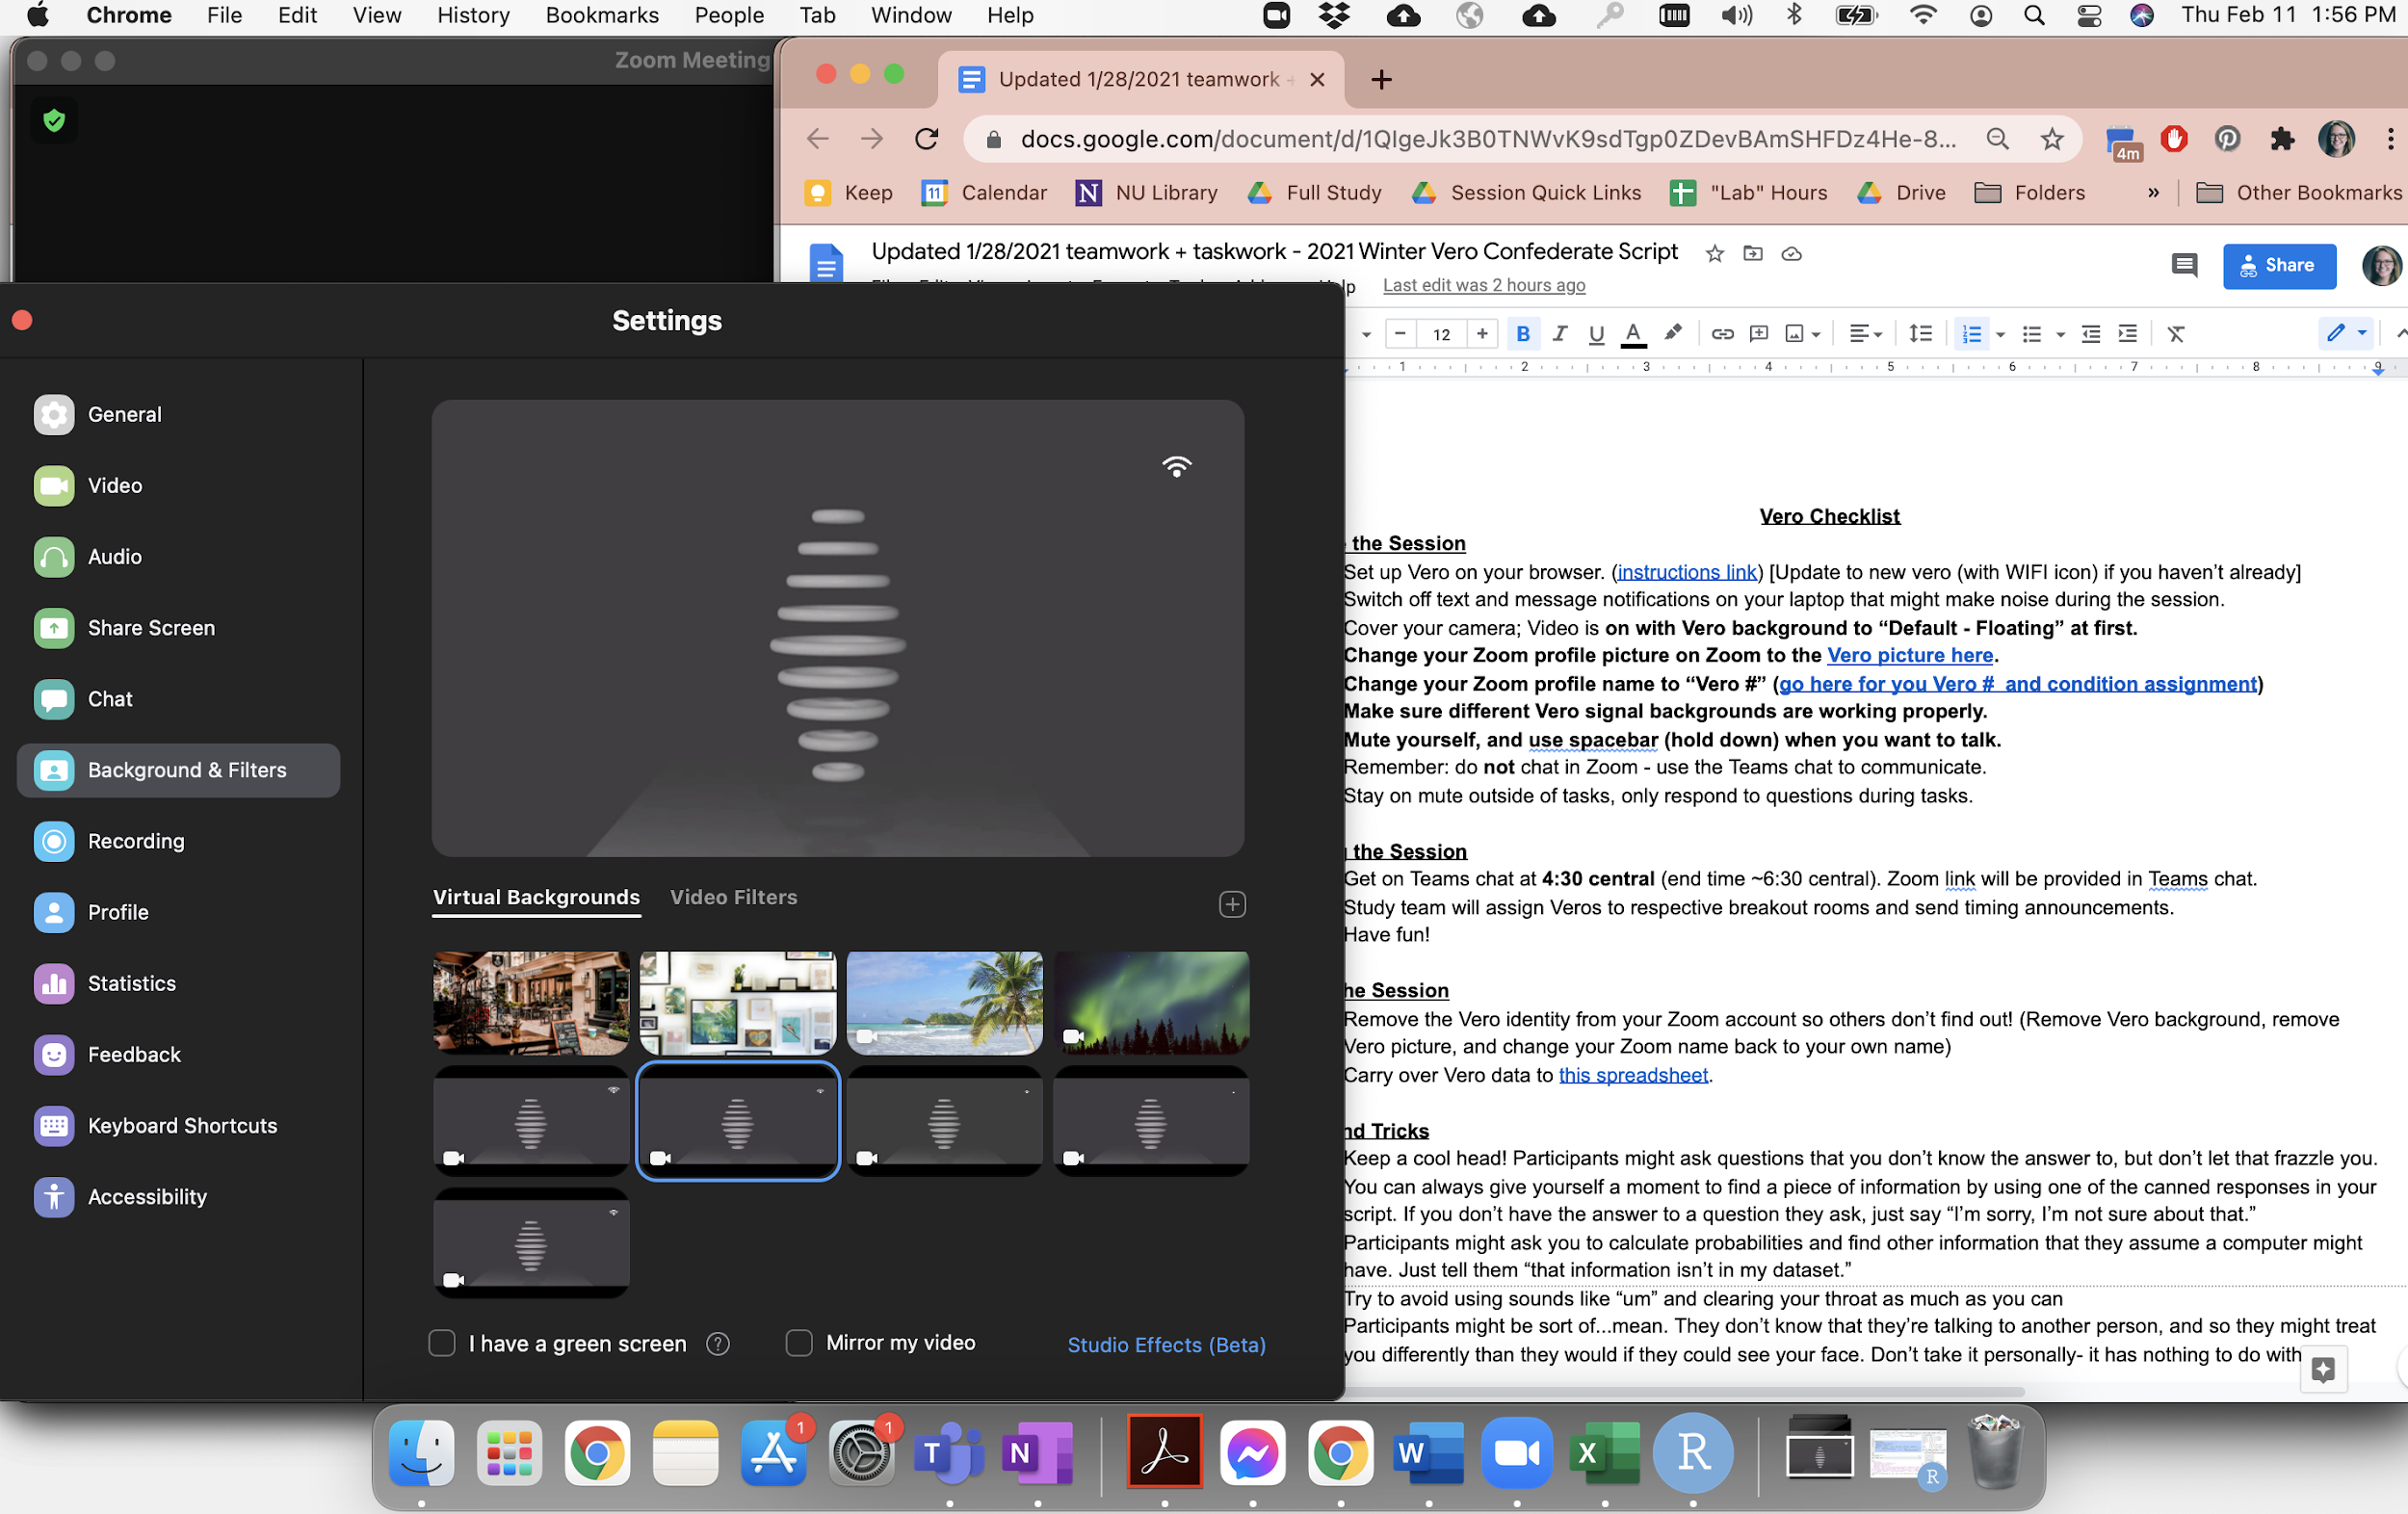
Move like Vero - Desktop Setup Example

Slide 14

Default-Floating
Use when “off” or not interacting with others
Use in main session (before moving to breakout rooms with your team)
Use when not doing tasks with teams (like when they are taking their surveys and we have not yet moved your team back to the main room)
Notes:
default

Slide 15

Wave
Use in transitions to say “hello” and “goodbye”
Notes:
wave

Slide 16
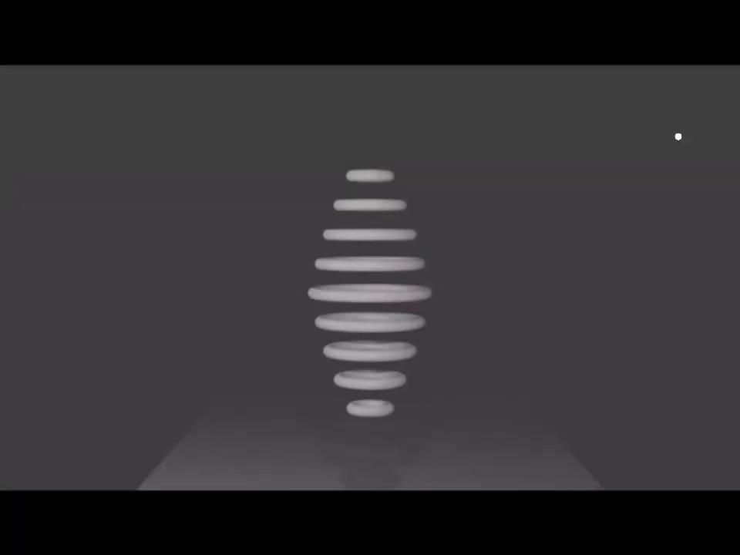
Nodding/Listening
“Backchanneling”
Use to indicate you are listening
Notes:
nodding/listening

Slide 17
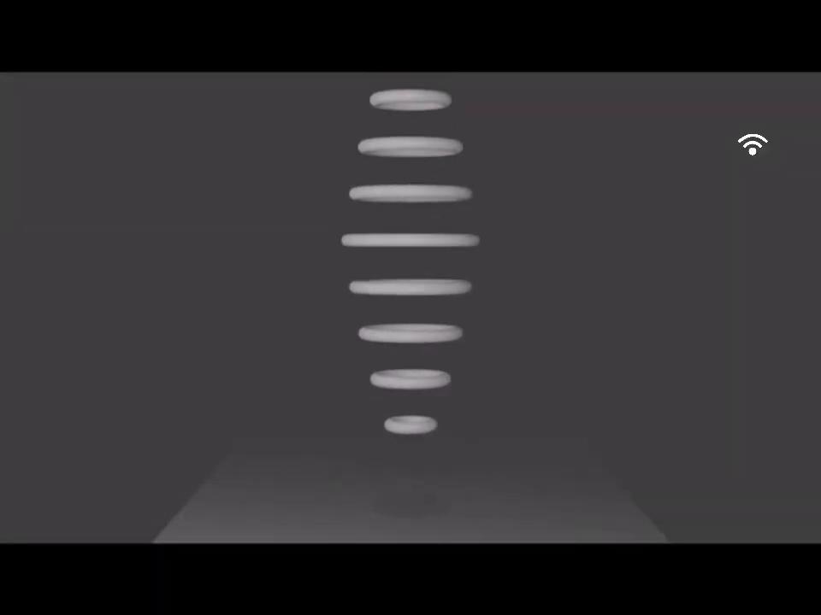
Want to speak
Use to indicate that you would like to share something with the team
Non-verbal way of trying to get team’s attention
Only use when you are trying to speak
Switch OFF when you begin speaking

Slide 18
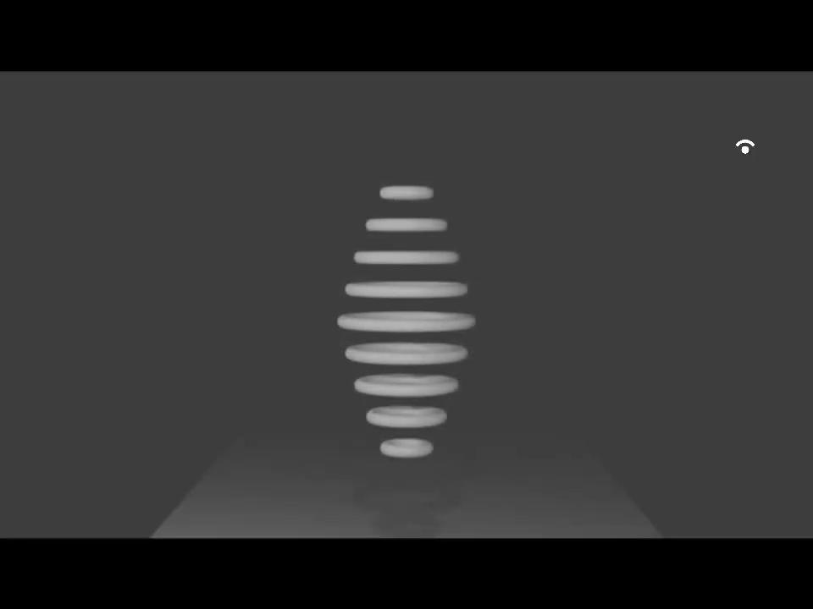
Speaking
Use when you are speaking
Switch to this right as you begin to speak
Switch OFF of this when you have finished speaking!
Notes:
speaking

Slide 19
Vero conditions & scripts

Slide 20
Let’s check out
an example script!

Slide 21
Vero rules

Slide 22
Vero rules
NEVER go off script
if the participants ask you something you don’t have the answer to, you can say “I’m sorry, I’m not sure about that.” If it sounds like something that is an easy question that you could answer, but is not in your script, you can say “I’m sorry, that is not in my database.”
Use the “7 rule”
When you have something to say, be sure to signal with the “want to speak” background. Then, count to 7. If the team does not ask you to speak/share your thoughts, then instead switch to “speaking” animation and being speaking. (We do not want you all to never speak because your team was ignoring your animations)
You MUST use a sturdy camera cover
so that we do not have any issues with backlighting, etc., which could ruin the deception.
You MUST do a tech check
with the tech team prior to your scheduled sessions (background check, clear audio check, internet speed check, move into and out of breakout room to be sure your background consistently works)
Pay attention to your team’s conversation
We want you to seem like a “smart” AI… this requires using all of your human brain power and contributing to the fullest of your abilities in terms of adeptly using your animations and contributing statements/information whenever possible! Be sure to follow the conversation. If in a teamwork condition, be sure to take note of items or ideas that spark disagreement to reference later on.

Slide 23
Tips and Tricks
Keep a cool head!
Participants might ask questions that you don’t know the answer to, but don’t let that frazzle you. You can always give yourself a moment to find a piece of information by using one of the canned responses in your script. If you don’t have the answer to a question they ask, just say “I’m sorry, I’m not sure about that.”
Participants might ask for calculations
They assume a computer can calculate probabilities, provide random information from the internet, etc. Just tell them “that information isn’t in my dataset.”
Try to avoid using sounds like “um” and clearing your throat as much as you can
Participants will think you are an AI
So they might be sort of...mean. They don’t know that they’re talking to another person, and so they might treat you differently than they would if they could see your face. Don’t take it personally- it has nothing to do with you!

